Slide 1


Santiago Bonilla Cárdenas
May 12th of 2023

Slide 2

Outline
Executive Summary
Introduction
Methodology
Results
Conclusion
Appendix

Slide 3
Executive Summary
Summary of methodologies
This project uses a wide array of techniques to provide valuable insights on the variables that determine the success of Stage-1 landing of SpaceX Falcon 9 rocket launches. With a variety of Python libraries and methods we collect, wrangle, prepare and visualize Falcon 9 launch data from 2010 to 2020, which allows us to then build several classification models to predict whether Stage-1 of a rocket mission will successfully land, thus significantly reducing launch costs.
Summary of findings
We find that, as the number of flights grows at a launch site, the success rate of said launch site will increase; at the same time, the success rate of all launch sites increases from 2013 onward. On the other hand, KSC LC-39A is the most successful launch site from all sites in the database, and the highest success rate orbits for launching rockets are ES-L1, GEO, HEO, SSO, and VLEO.

Slide 4
Introduction
Background:
According to SpaceX official information, Falcon 9 rocket launches cost about 62 million dollars, which turns out to be significantly cheaper than launch costs of its competitors, which are above 165 million dollars each. The reason is that the first stage of Falcon 9 is reusable, provided that it lands successfully. Hence, one of the most important pieces of information for SpaceX competitors to estimate launch costs is whether a rocket mission will successfully recuperate its first stage or not.
Problems to find answers to:
¿What are the main factors affecting the landing outcome of the rocket?
¿Which predictive models can better help us to estimate the landing success of a rocket?

Slide 5

Section 1

Slide 6
Methodology
Executive Summary
Data collection methodology:
The data we use for this project was obtained by running a series of requests to a SpaceX API, and by performing a web scraping process on the Wikipedia page for SpaceX.
Perform data wrangling
Using many Python libraries and methods, we create the dummy feature “Class”, which has a value of 1 if the landing was successful, and 0 otherwise. Similarly, we use one-hot encoding to obtain many binary variables representing various categorical features.
Perform exploratory data analysis (EDA) using visualization and SQL
Perform interactive visual analytics using Folium and Plotly Dash
Perform predictive analysis using classification models
We use several scikit learn libraries for classification models, which we train with a subset of our data, and use test data to obtain their predictions. We optimize their parameters using GridSearchCV.

Slide 7
Data Collection
We collect our data using several methods.
First, we use the SpaceX API, to which we send a request and get its response.
Then, we decode the response content as a Json file and turn it into a Pandas dataframe.
After this, we perform data cleaning and wrangling, checking for missing values and filling them with the mean, in the specific case of the “Payload mass” feature.
We also use web scraping on the Wikipedia page for Falcon 9 launch records, using the Beautiful Soup library, thus extracting the launch records as an HTML table, to then parse the table and turn it to a pandas dataframe.

Slide 8
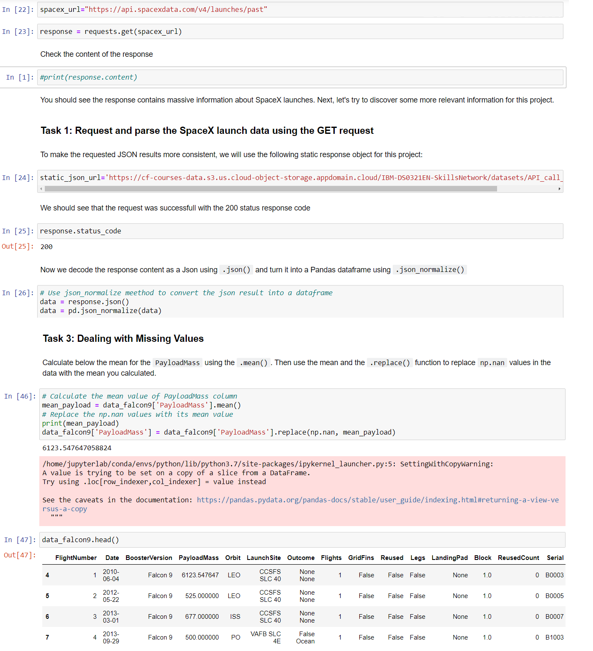
Data Collection – SpaceX API
Here we can see part of the code we use to run the request to the SpaceX API, to then convert the Json response to a Pandas dataframe, as well as dealing with missing values.
Link to the GitHub repository for the full Jupyter notebook:
https://github.com/sbch86/my_ibm_captsone_project/blob/main/COMPLETED_jupyter-labs-spacex-data-collection-api.ipynb
Place your flowchart of SpaceX API calls here

Slide 9
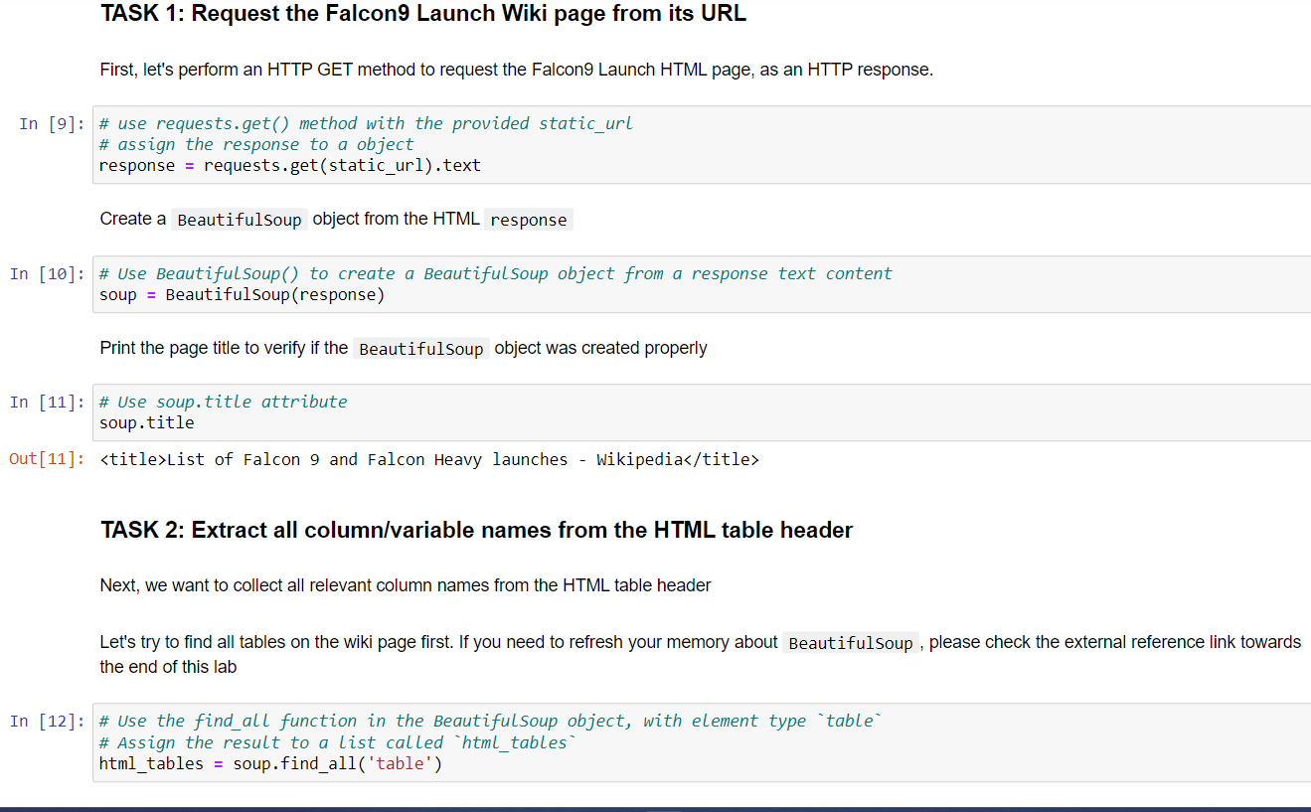
Data Collection - Scraping
We use Beautiful Soup to web scrape data from the Wike page of SpaceX.
Link to the GitHub repository for the full Jupyter notebook:
https://github.com/sbch86/my_ibm_captsone_project/blob/main/COMPLETED_jupyter-labs-webscraping.ipynb
Place your flowchart of web scraping here

Slide 10
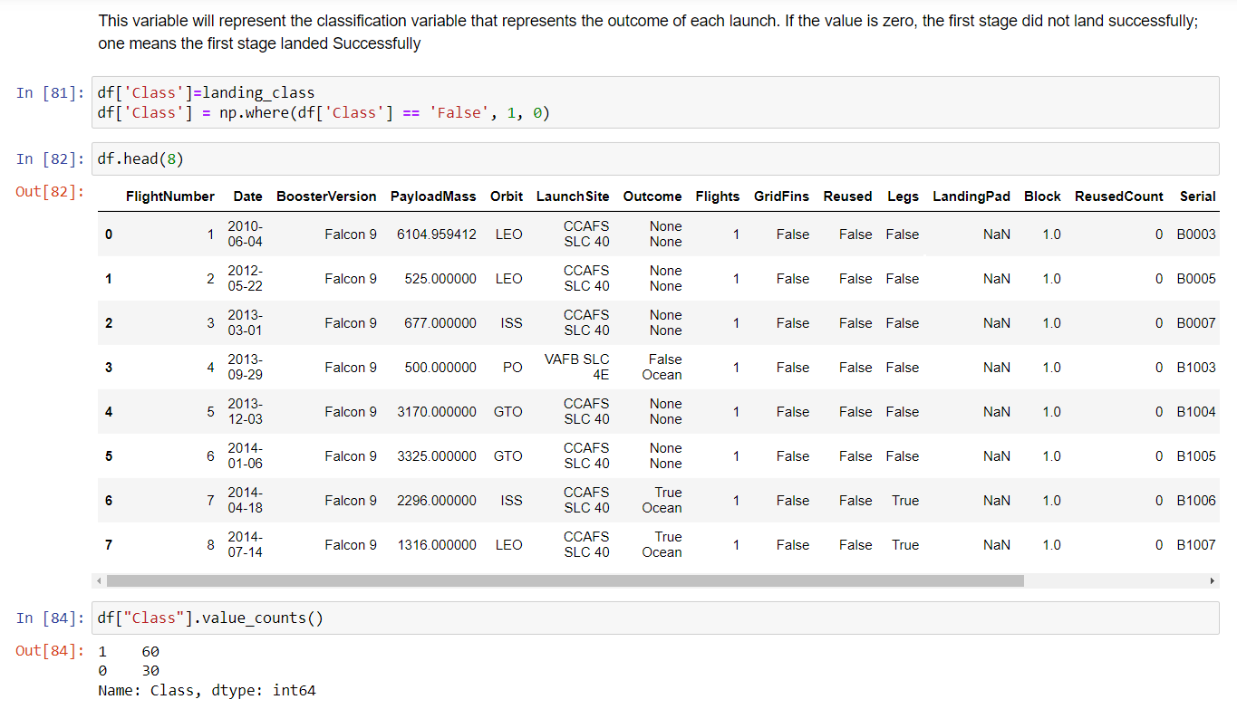
Data Wrangling
Describe how data were processed
In this part we use the categorical feature “landing_outcomes” in order to create the new variable “Class”, corresponding to 1 if the landing outcome was successful, and zero otherwise.
Link to the GitHub repository for the full Jupyter notebook:
https://github.com/sbch86/my_ibm_captsone_project/blob/main/COMPLETED_labs-jupyter-spacex-data_wrangling_jupyterlite.jupyterlite.ipynb

Slide 11
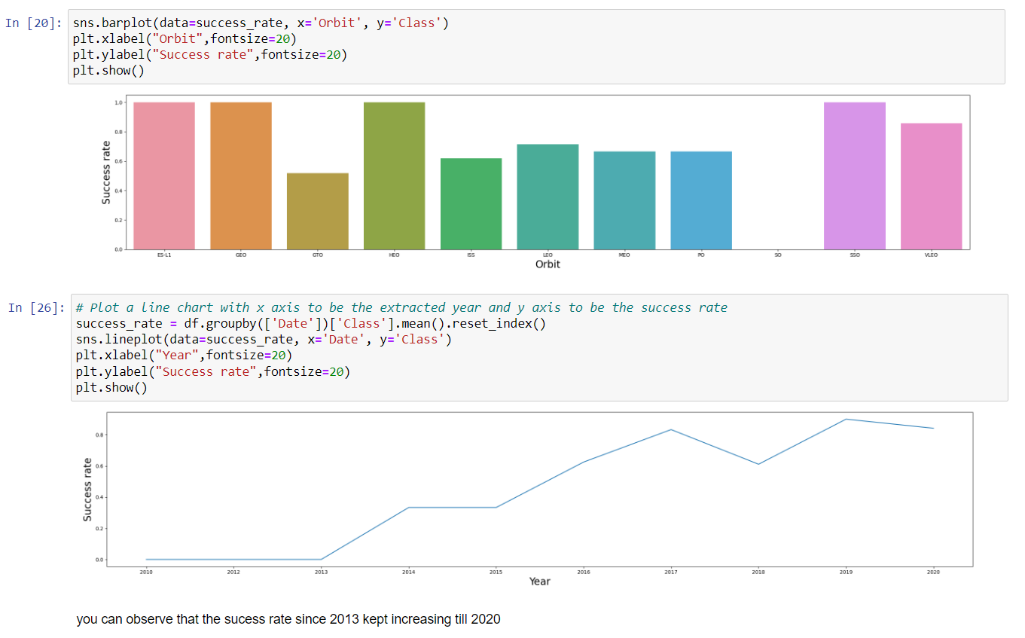
EDA with Data Visualization
We explore the relationship among several launch features, such as Launchsite vs. Flight number, Launchsite vs. Payload mass, Orbit vs. Success rate, Orbit type vs. Flight number and Payload mass. Finally, we chart a line plot showing the Success rate trend throughout the years.
Link to the GitHub repository for the full Jupyter notebook:
https://github.com/sbch86/my_ibm_captsone_project/blob/main/COMPLETED_jupyter-labs-eda-dataviz.ipynb.jupyterlite.ipynb

Slide 12
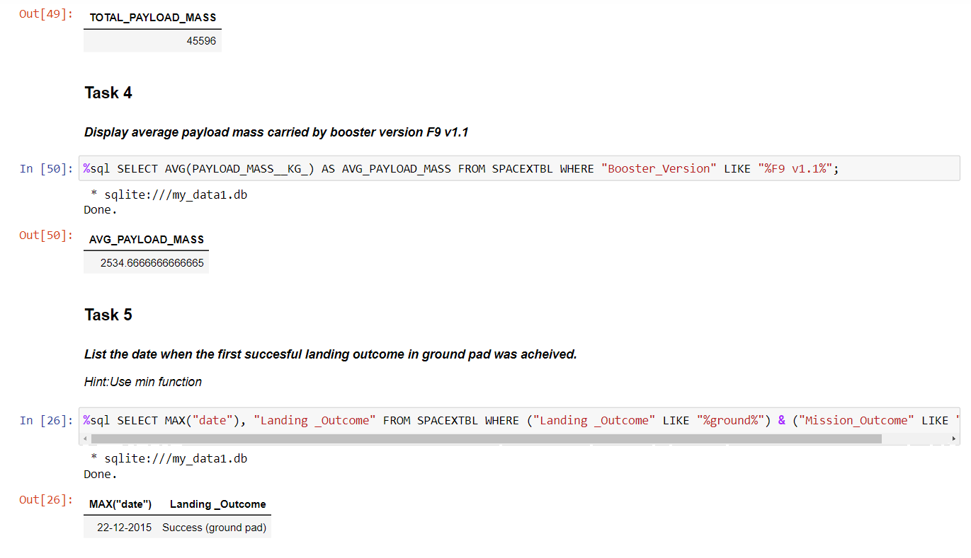
EDA with SQL
In this part, we use SQL alchemy to perform various SQL queries from our Jupyter notebook, as follows:
Display the names of the unique launch sites in the space mission
Display 5 records where launch sites begin with the string 'CCA'
Display the total payload mass carried by boosters launched by NASA (CRS)
Display average payload mass carried by booster version F9 v1.1
List the date when the first successful landing outcome in ground pad was achieved.
List the names of the boosters which have success in drone ship and have payload mass greater than 4000 but less than 6000
List the total number of successful and failure mission outcomes
List the names of the booster versions which have carried the maximum payload mass
List the records which will display the month names, failure landing_outcomes in drone ship, booster versions, launch_site for the months in year 2015
Rank the count of successful landing_outcomes between the date 04-06-2010 and 20-03-2017 in descending order.
https://github.com/sbch86/my_ibm_captsone_project/blob/main/COMPLETED_jupyter-labs-eda-sql-coursera_sqllite%20(1).ipynb

Slide 13
Build an Interactive Map with Folium
In this part, we use Folium library to display a map with all launch sites and added objects like markers and circles to show the success or failure of launches for each site.
Using marker clusters, we identify which launch sites have relatively high and low success rate.
We calculate the distances between a launch site to any of its proximities, in order to answer questions like:
Are launch sites near railways, highways and coastlines.
Do launch sites keep certain distance away from cities.
https://github.com/sbch86/my_ibm_captsone_project/blob/main/COMPLETED_lab_jupyter_launch_site_location.jupyterlite.ipynb

Slide 14
Build a Dashboard with Plotly Dash
We build an interactive dashboard using the Plotly dash library.
We plot pie charts showing total launches at specific sites.
We build scatter plots showing the relationship between Landing Outcome and Payload Mass (Kg) for the different booster versions.

Slide 15
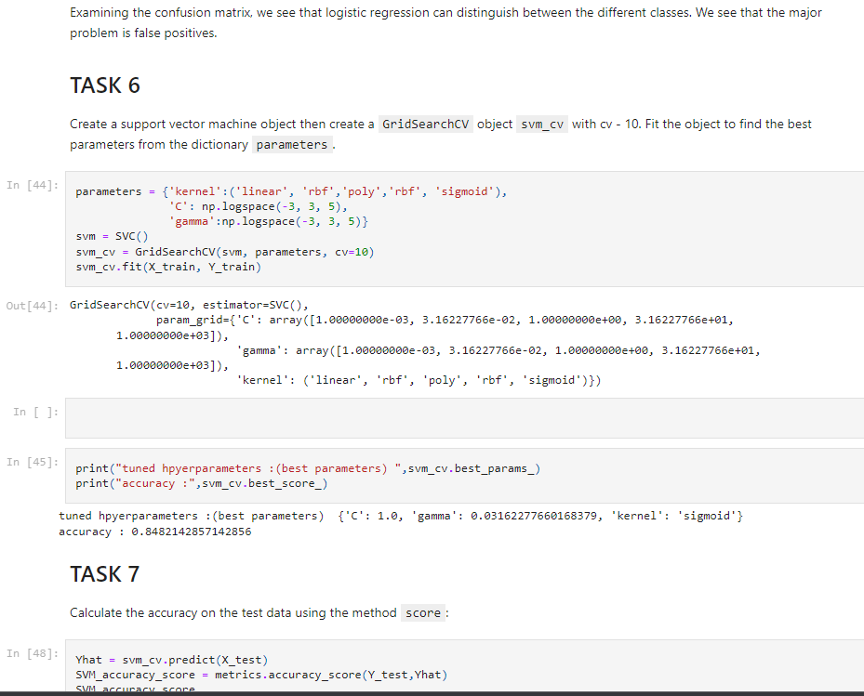
Predictive Analysis (Classification)
In this part we use Numpy, Pandas and Scikit learn, to transform the data, split it into training and testing, and then build machine learning classification models, tuning them with different hyperparameters using GridSearchCV to determine which of these generate the most accurate results.
We use the accuracy score as the metric for our model in order to find the best performing model.
https://github.com/sbch86/my_ibm_captsone_project/blob/main/COMPLETED_SpaceX_Machine_Learning_Prediction_Part_5.jupyterlite%20(1).ipynb

Slide 16
Results
We find that the highest success rate orbits for launching rockets are ES-L1, GEO, HEO, SSO, and VLEO. Also, success rates have been growing from 2013 to 2020.
With respect to our prediction models, we find that Logistic regression, Support vector machine, Decision trees and K-nearest neighbors perform equally well on the test data subset in terms of accuracy score, once their hyperparameters have been optimized.

Slide 17

Section 2

Slide 18
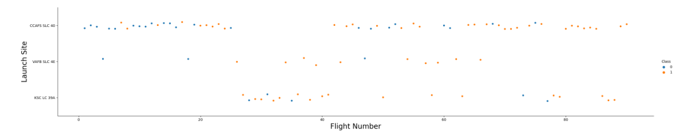
Flight Number vs. Launch Site
From the below figure, we can conclude that the higher the number of flights in a launch site, the better it will perform in terms of successful landings.

Slide 19
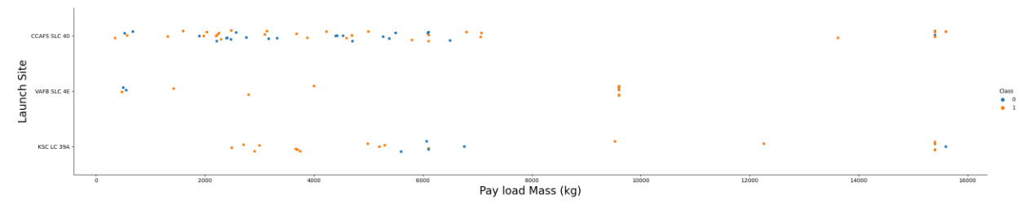
Payload vs. Launch Site
According to the below figure, launch site CCAFS SLC 40 has not been particularly successful with lighter rockets (mass under 8000 kgs). However, for heavier payloads, its success rate increases.

Slide 20
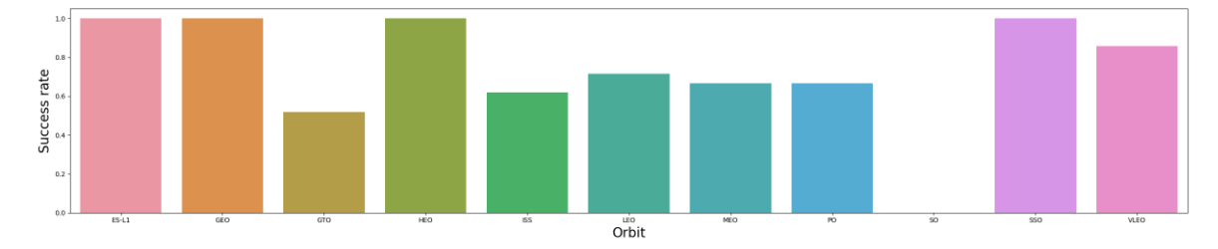
Success Rate vs. Orbit Type
From the figure below, we can determine that the most successful orbits are ES-L1, GEO, HEO, SSO, VLEO.

Slide 21
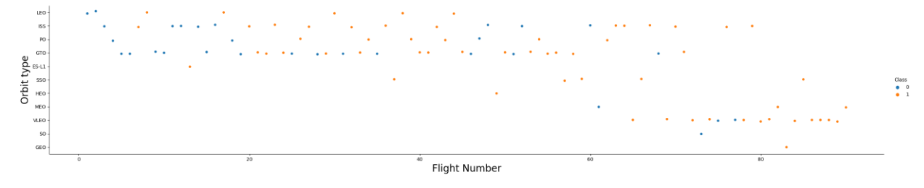
Flight Number vs. Orbit Type
We can conclude that, in the case of LEO orbit, success is related to a higher number of flights. However, in the GTO orbit there appears to be no relationship between flight number and the orbit, as even when flight number rises, we still find unsuccessful landings.

Slide 22
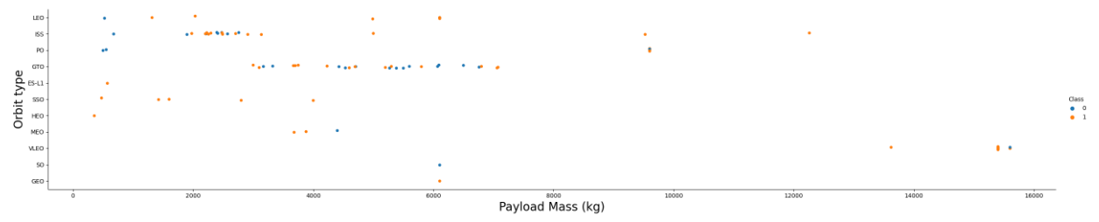
Payload vs. Orbit Type
For lighter payload masses, SSO orbit is the most successful. However, for heavier masses, VLEO and ISS tend to be more successful in terms of landing outcome.

Slide 23
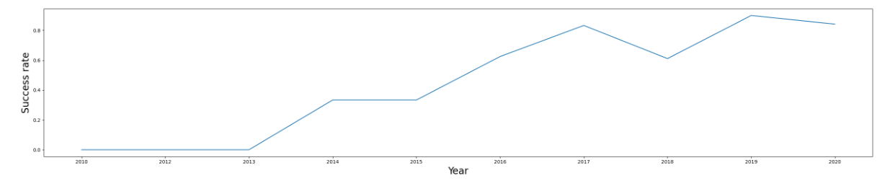
Launch Success Yearly Trend
The figure below shows that average success rate has been steadily growing from 2013 to 2020.

Slide 24
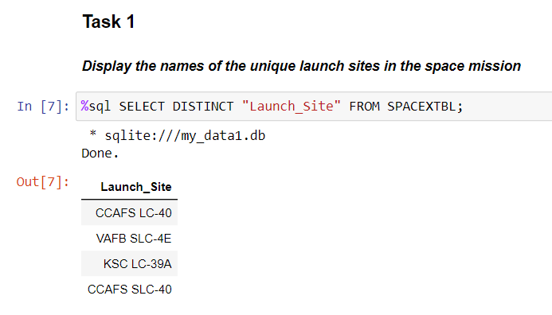
All Launch Site Names
The only launch sites in our database are the 4 shown below. We use the DISTINCT command.

Slide 25
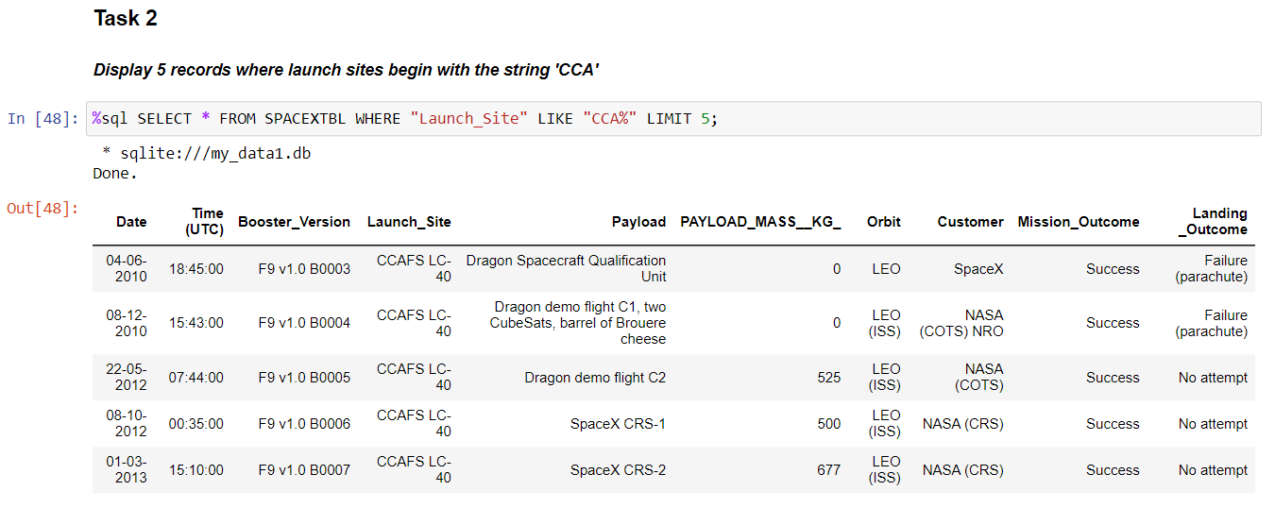
Launch Site Names Begin with 'CCA'
To find those specific records, we use the LIKE command together with “CCA%” key, using LIMIT 5 too.

Slide 26
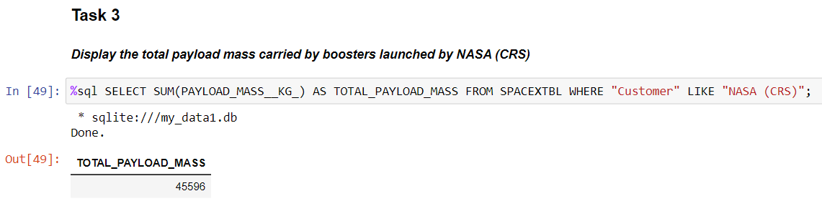
Total Payload Mass
We use the SUM function, filtering for the NASA customer.

Slide 27
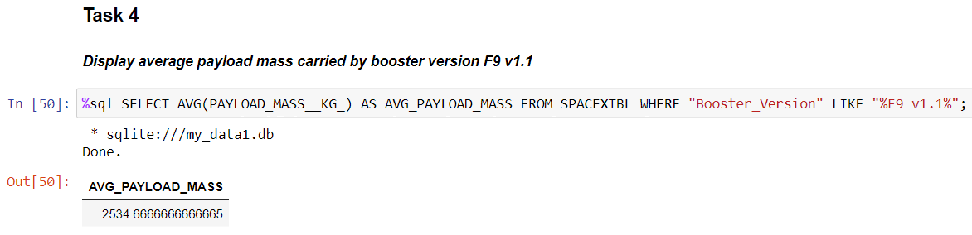
Average Payload Mass by F9 v1.1
In this case, we filter for the required booster version, and use AVG function.

Slide 28
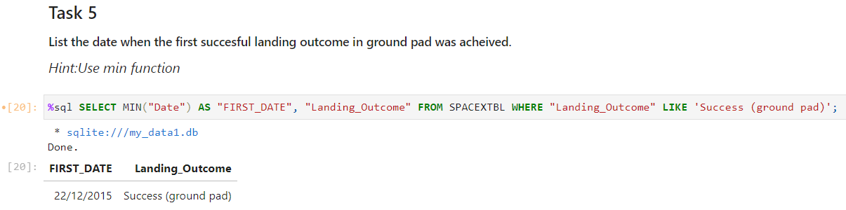
First Successful Ground Landing Date
The date of first successful landing on ground pad was 22 of December 2015.

Slide 29
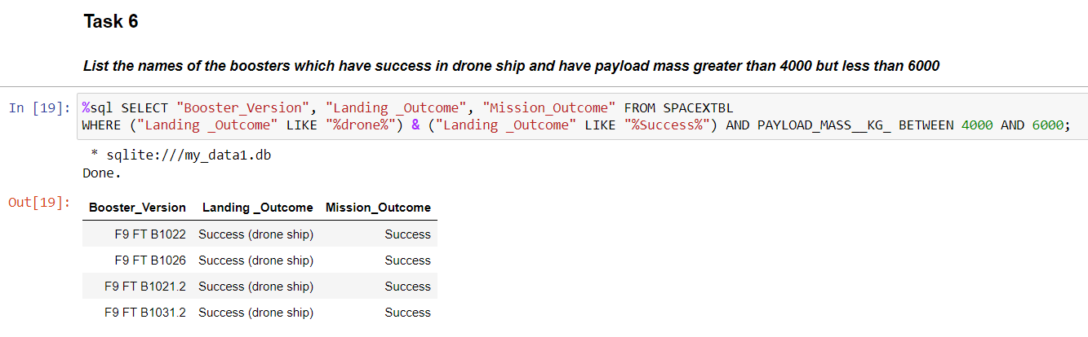
Successful Drone Ship Landing with Payload between 4000 and 6000
These are the names of boosters which have successfully landed on drone ship and had payload mass greater than 4000 but less than 6000

Slide 30
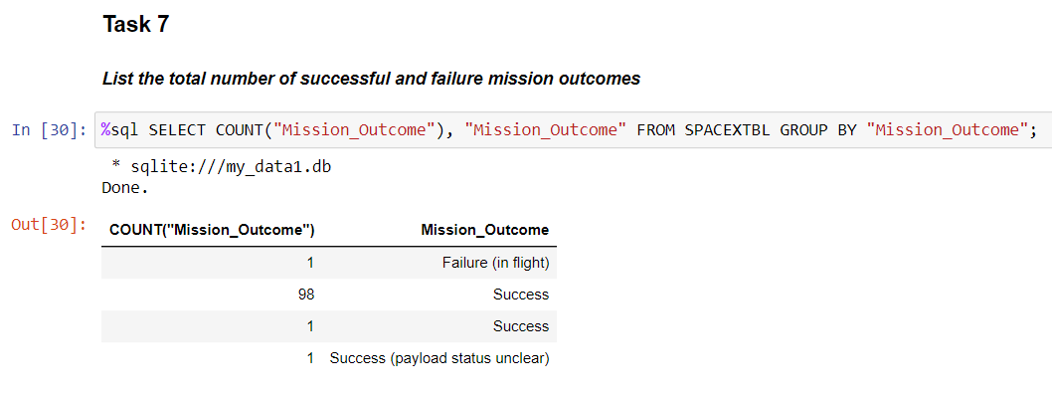
Total Number of Successful and Failure Mission Outcomes
Here we see the total number of successful and failure mission outcomes: 100 total successes, and 1 failure in flight.

Slide 31
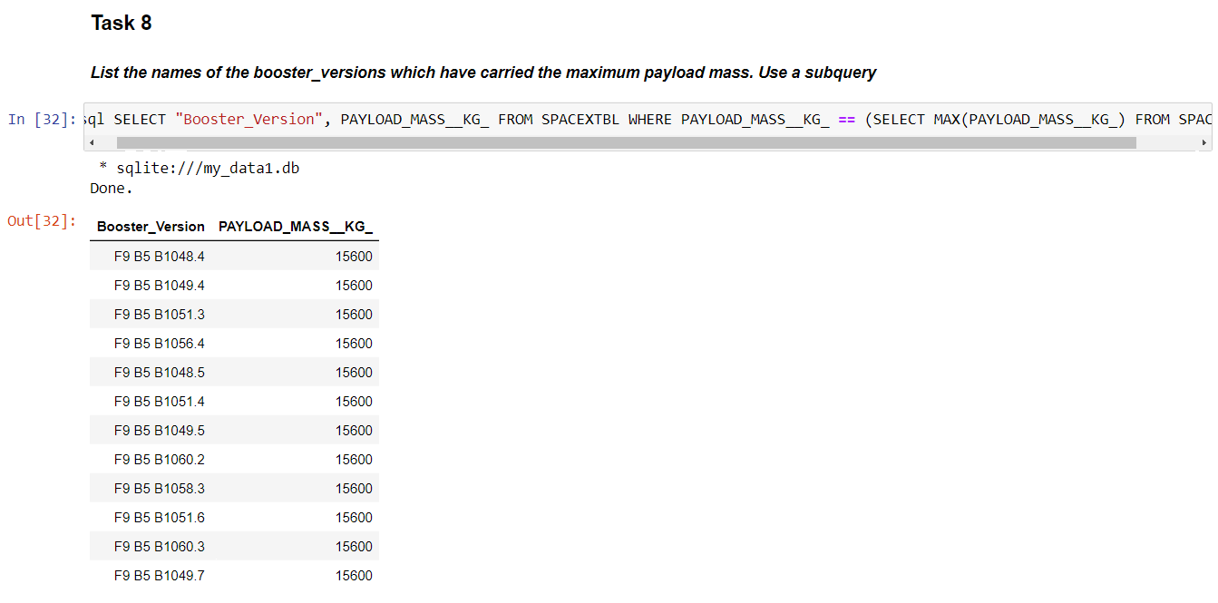
Boosters Carried Maximum Payload
These are the boosters which have carried the maximum payload mass.

Slide 32
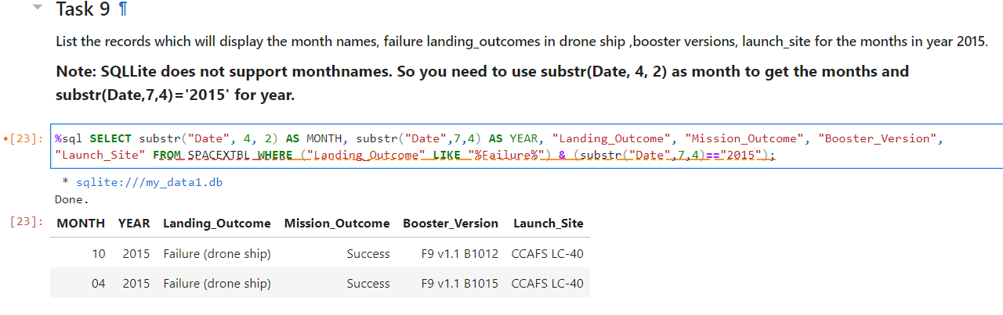
2015 Launch Records
This is the list of failed landing_outcomes in drone ship, their booster versions, and launch site names for in year 2015

Slide 33
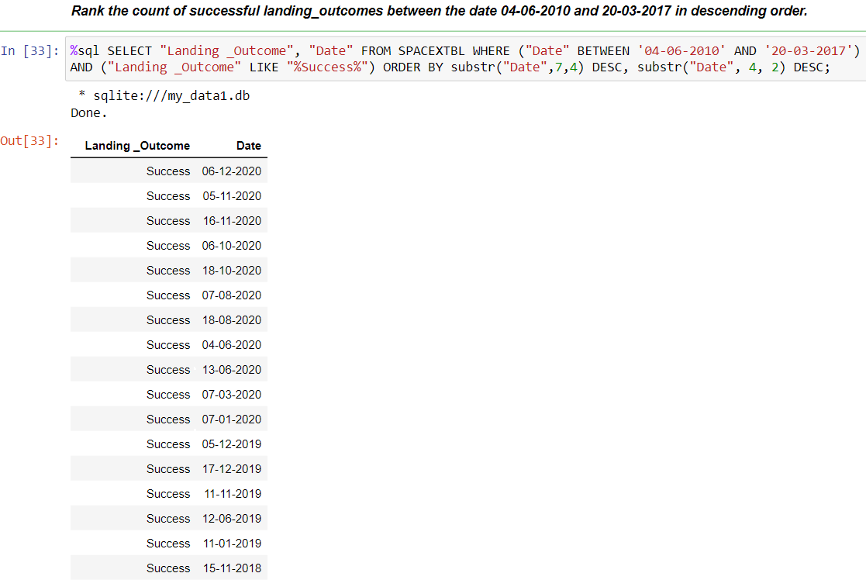
Rank Landing Outcomes Between 2010-06-04 and 2017-03-20
This is the count of landing outcomes (such as Failure (drone ship) or Success (ground pad)) between the date 2010-06-04 and 2017-03-20, in descending order.
Note: the whole output
Didn’t fit in the screenshot

Slide 34

Section 3

Slide 35
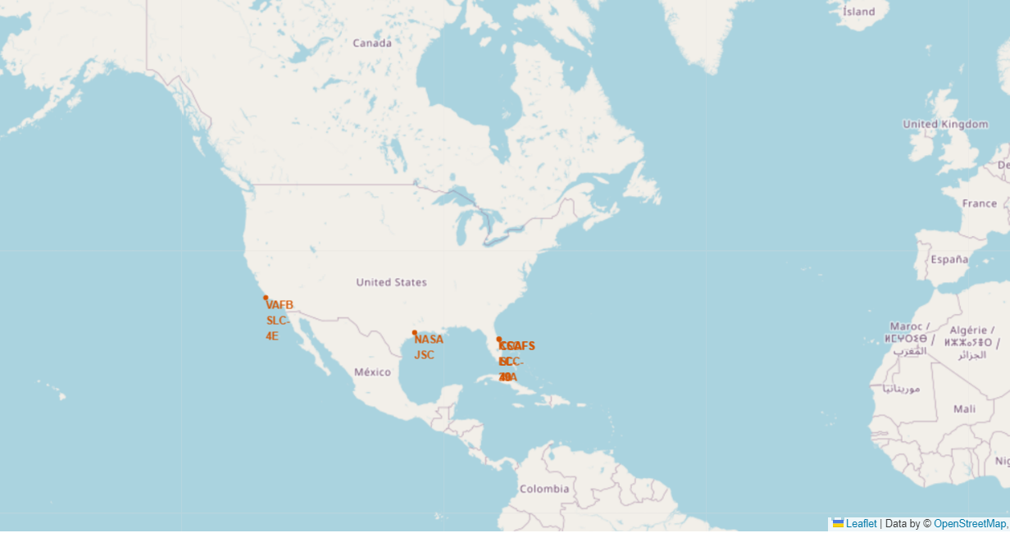
Global map of all launch sites with markers
Here we see all launch sites plus the NASA headquarters in Houston.

Slide 36
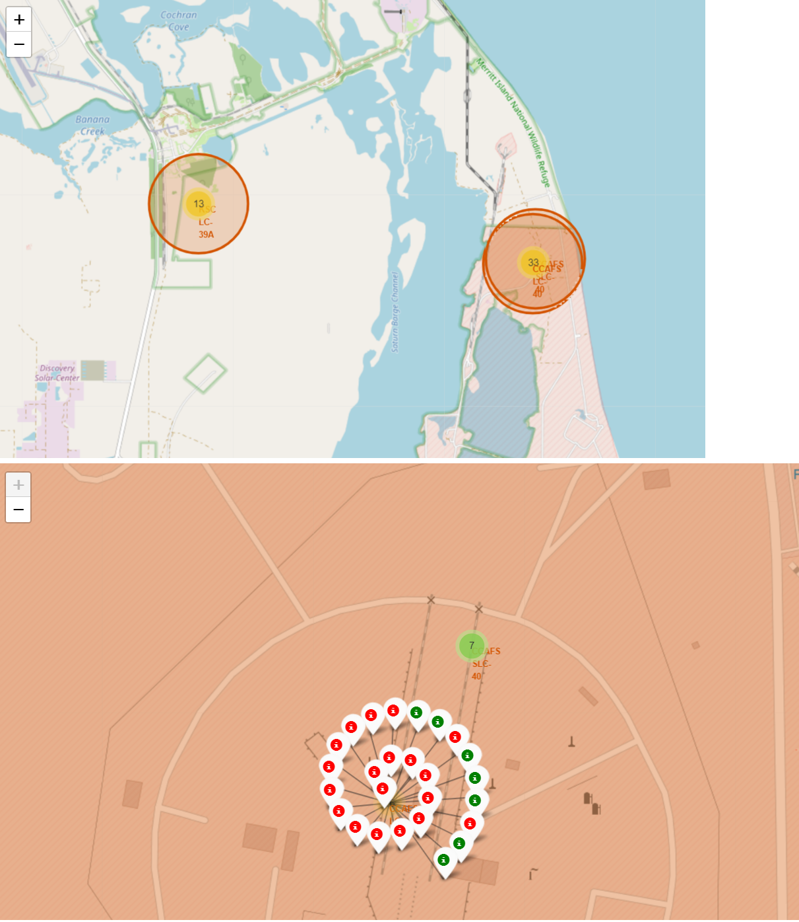
Markers showing launch sites and their successes/failures
This is the map that also
shows successes (green) and
failures

Slide 37
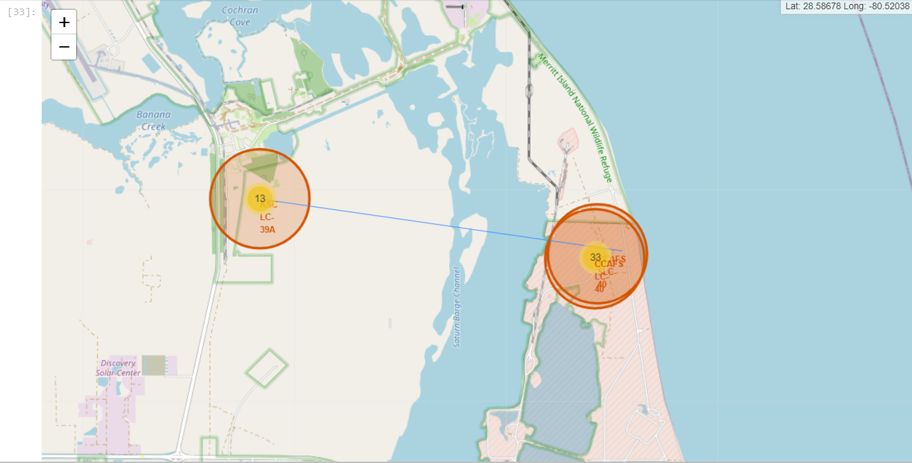
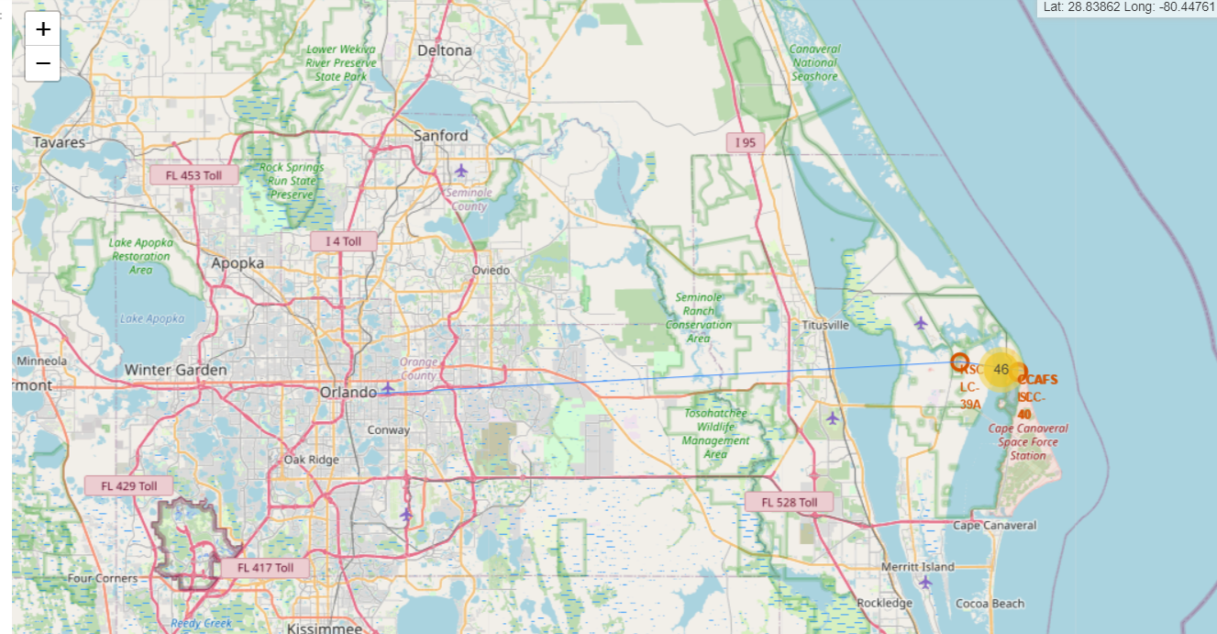
Launch Site distance to landmarks
This map shows the distance between two launch sites, and between KSC LC39A and Orlando.

Slide 38

Section 4

Slide 39
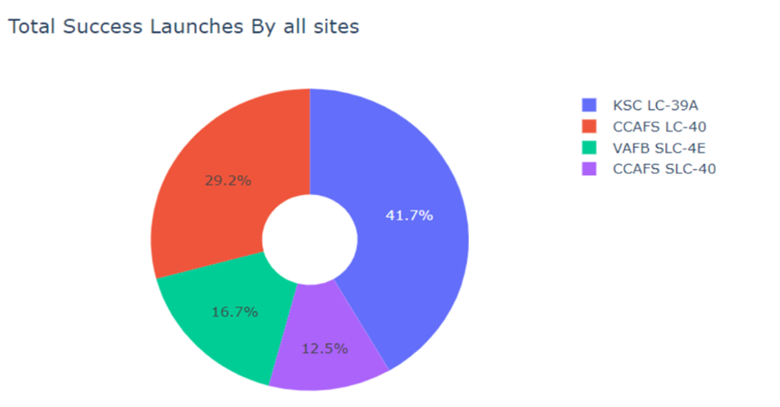
Pie chart: success rate achieved by each launch site
We observe that KSC LC39A is the most successful site.

Slide 40
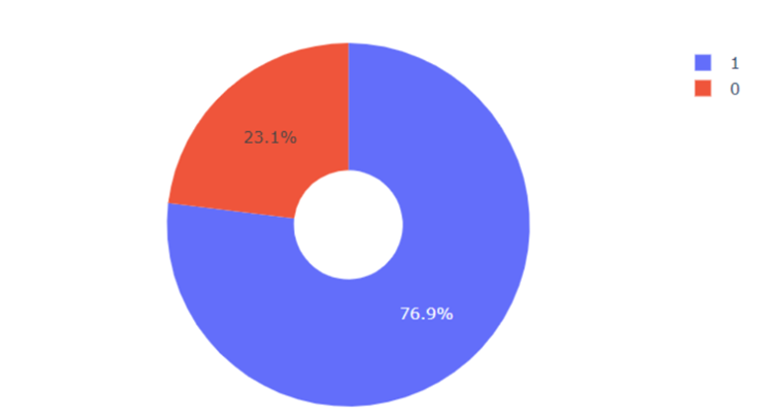
Pie chart: most successful launch site
We observe that KSC LC39A has a success rate of 76.9%

Slide 41
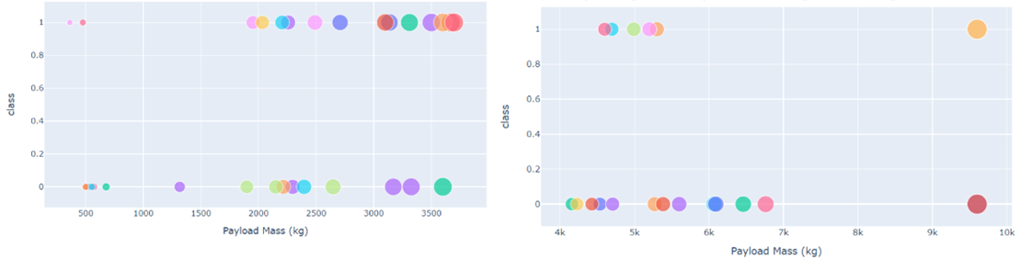
Scatter plot: Payload Mass vs Launch Outcome for all sites; different payloads selected with the slider
The left figure shows the scatter plot for light Payload masses (0 – 4000kgs), and the right one for heavy Payload Masses (4000 – 10000kgs)

Slide 42

Section 5

Slide 43
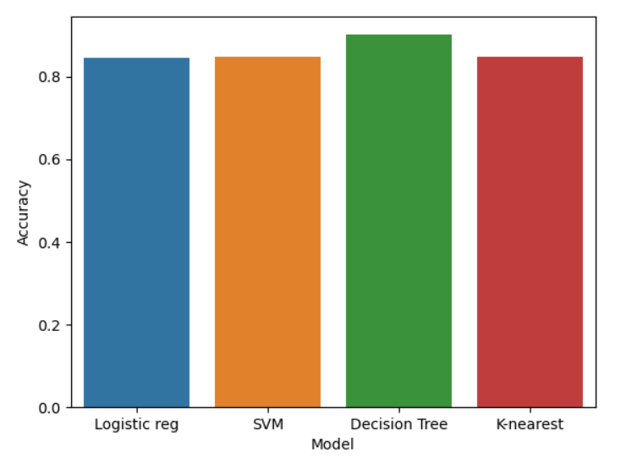
Classification Accuracy
The model with the highest accuracy in the train sample was the Decision Tree.

Slide 44
Confusion Matrix
This is the confusion matrix of the Decision Tree. We can see that there are no false negatives. However, there are false positives (3/12)= 25%

Slide 45
Conclusions
We have performed a comprehensive analysis of the SpaceX data, which we obtain by a request to SpaceX API, and web scraping, and after cleaning and wrangling the data, we proceed to visualize and construct several insightful queries. Finally, we build machine learning models to predict the success of rocket landings.
We find that, as the number of flights grows at a launch site, the success rate of said launch site will increase.
The success rate of all launch sites increases from 2013 onward. On the other hand, KSC LC-39A is the most successful launch site from all sites in the database, and the highest success rate orbits for launching rockets are ES-L1, GEO, HEO, SSO, and VLEO.
Finally, the best performing model to predict the success of a Stage-1 landing is the Decision Tree classifier.

Slide 46


